Slide 1
2FACloud
Amir Omidi, Jason Gallagher
Omair Bhore & Michael Needleman

Slide 2
Project Idea
With all the password leaks that are happening in the past few months, it shows there is a greater need for 2 factor authentication. Unfortunately current 2FA solutions work as long as your phone works, and if you lose your phone you will have to use backup keys to access your account.
Creating a zero knowledge web application that syncs the two factor authorization private keys in an encrypted manner with the server.

Slide 3
Functional Requirements
The user logs in with their username and password, their password is hashed and sent to the server. The server hashes their hash and checks it with the database.
Once the user logs in, the server sends the encrypted keys to the client and the client decrypts them with their password. The server has no information about what the keys actually are.
Once you’re logged in, you’re going to be greeted with a web page that has all your 2FA keys and a timer that creates new TOTP tokens every 30 seconds.
The website will have QR code reading and export/import functions for a better UX

Slide 4
Scope of developments
These are sorted by their priority:
Database Structure
Register page and code
Login page and code
Adding 2FA private keys from images and secrets
Viewing 2FA keys that are already on the server for that user
Removing 2FA keys
Changing password
Forgetting password
Import/Export

Slide 5
Information Flow - Register
User will register with their username, email and password. Their
Password will be hashed with a very simple hash function (MD5) and
sent to the server. Then the client has to set up a 2FA key with this
account (in case their password is leaked, malicious users don’t have
complete access to their 2fa keys). Once they set their 2FA key, their
account is created and they can sign in.
Register
USERNAME
PASSWORD
EMAIL
NAME
SIGN UP

Slide 6
Information Flow - Login
User will login with their username and password. Once logged in,
if the device is not recognized the user will have to provide a 2FA
generated password created when making their account.
Once that is completed, the server will send the private components
of the 2FA keys stored on the web service to the user
LOG IN
USERNAME
PASSWORD
NOT REGISTERED ?? SIGNUP

Slide 7
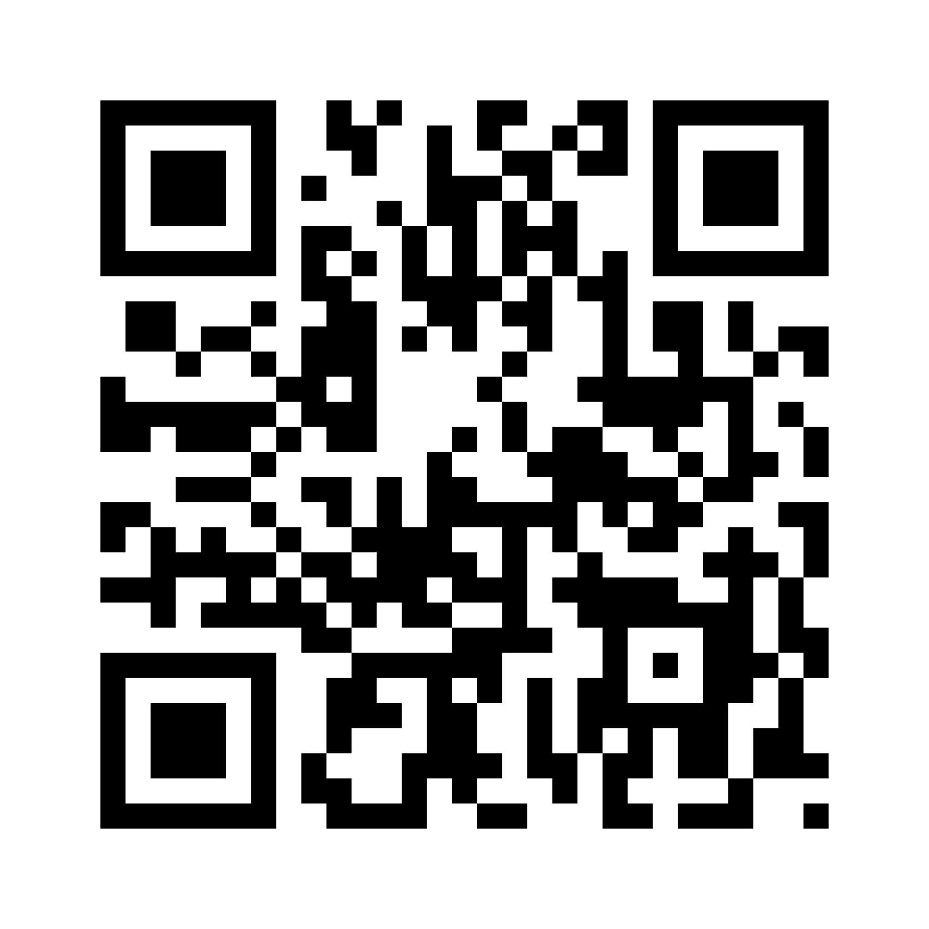
Information Flow - Adding 2FA Codes
The user will be able to scan QR codes or enter the codes for the 2FA
codes manually. These codes are encrypted with the password of the
user on the client side and get sent to the server. The server stores
the encrypted values to be used for later use.
Change 2FA
Enter 2FA
Submit

Slide 8
Information Flow - Changing password
All decrypted 2FA keys will have to be re encrypted with the key
provided. All known sessions will be forgotten and the user will have
to re login on all clients with the 2FA code provided at sign up.
Change password
USERNAME
OLD PASSWORD
NEW PASSWORD
RE ENTER NEW PASSWORD
Submit

Slide 9
Information Flow - Changing registration 2FA key
The 2FA key will only be changeable via the web interface and by
providing the password of the client. The 2FA key will not be disabled
in any way, either by email or other methods of communication.
This will worsen the UX but for a security aware product, we can’t
remove the 2FA key if the user has lost that 2FA key. The users will
be heavily encouraged to print the backup codes provided to them
at registration.

Slide 10
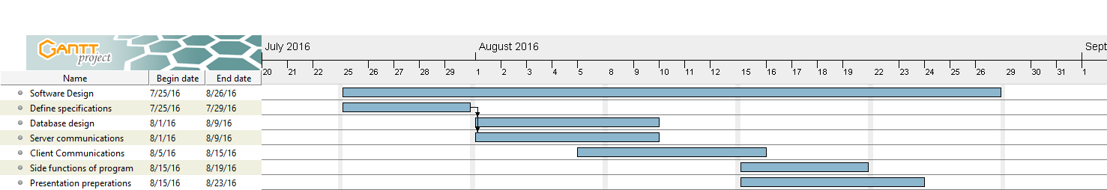
Gantt Chart

